Slide 1
Mesh Messages

Slide 2
Mesh Messages
An end to end secure asynchronous messaging control plane
End-to-end
Mesh Services cannot read the content of any message
Asynchronous
Store and forward
Sending and receiving devices do not need to be connected at the same time
Control plane
Messages are limited to 32KB
This has security advantages (come back to)
Messages of unlimited size can be fetched as linked attachments.
Access controlled
All messages are authenticated
Access control on the outbound and inbound service to mitigate abuse

Slide 3
Every Message is
Signed by the originating user (sender)
Countersigned by the originating service (forwarder)
End to end encrypted
Payload
Attributes (e.g. subject line)
Has plaintext recipient Internet address

Slide 4
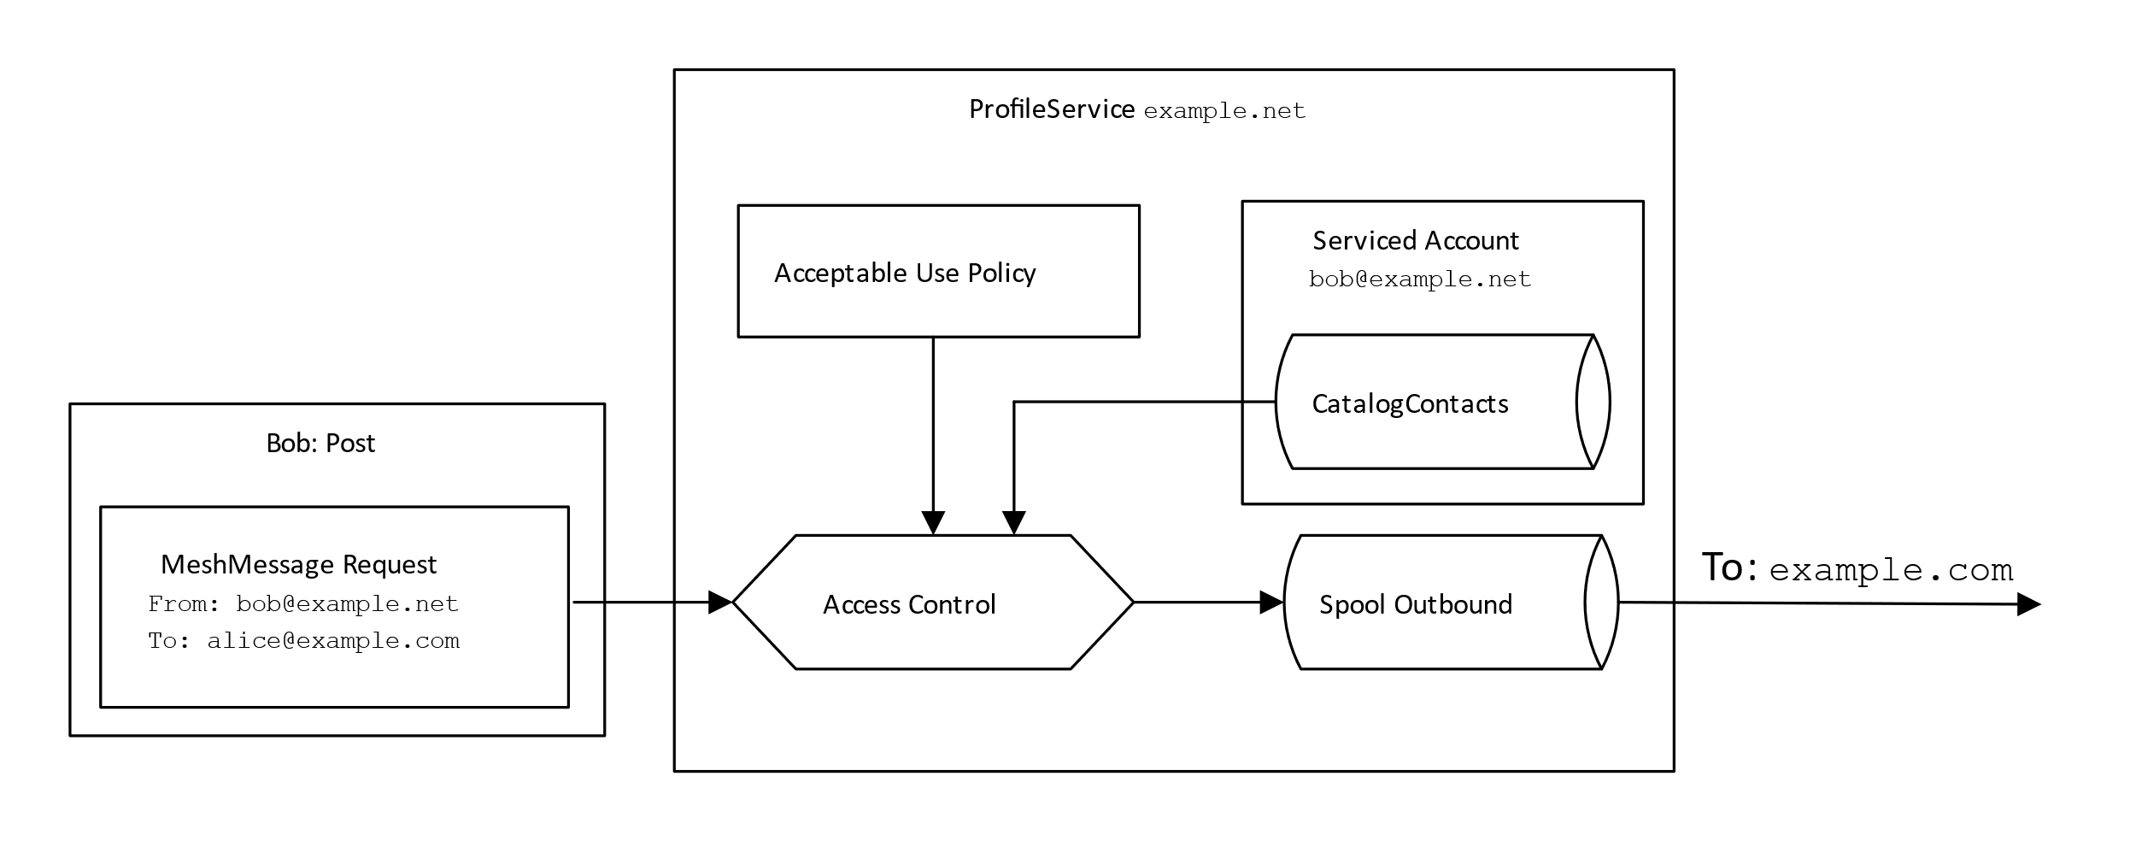

Slide 5
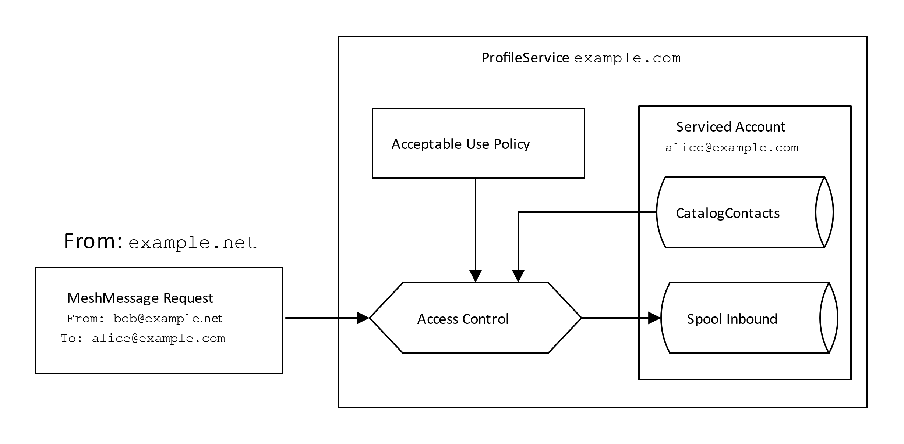

Slide 6
Why limit messages to 32KB?
Prevents large messages blocking the Mesh Service
Forces large messages to be sent as pull message
Alice sends Bob the video of the presentation (50GB) for editing
Bob does not want that on his tablet or his watch
Bob pulls it across from his desktop PC with Premiere loaded
Allows messages to be fixed size using padding
32KB is sufficient for control plane
Ed448 Key Agreement
Ed448 Signature
Short message 8KB or less

Slide 7
Onion routing
Alice sends message to Bob through four Mesh Services
Alice’s outbound service knows only that it is onion routed
‘To onion@example.net’
Does not know the ultimate recipient
Does not know the number of hops
Next service
Decrypts envelope
If for local party, delivers
Otherwise forwards
Mixmaster class????
Hmmm…. student projects…

